Slide 1
Math 21 Midterm Review
Part 1: Chapters 1-4

Slide 2
1) A survey of 500 randomly selected college students produced a mean age of 23.4 years old. Is the following statement an example of descriptive or inferential statistics?
“The mean age of all college students is greater than 22 years old.”

Slide 3
2) The scores on a career aptitude test are reported as poor, below average, average, above average, and superior.
What level of data would this be an example of?
Nominal
Ordinal
Interval
Ratio

Slide 4
3) The scores on an IQ test would be an example of what level of data?
Nominal
Ordinal
Interval
Ratio

Slide 5
4) A random sample of 98 high school students had their blood drawn. Their blood types (A, B, AB, O) would be an example of what level of data?
Nominal
Ordinal
Interval
Ratio

Slide 6
5) A frequency distribution is used to present the weights of 1641 eighth-grade boys. This would be an example of what level of data?
Nominal
Ordinal
Interval
Ratio

Slide 7
6) A student interested in the percentage of college students who have seriously considered dropping out of college gathers data by interviewing students who are buying textbooks at the bookstore.
This would be an example of what type of sampling?
Random
Convenience
Systematic
Cluster
Stratified

Slide 8
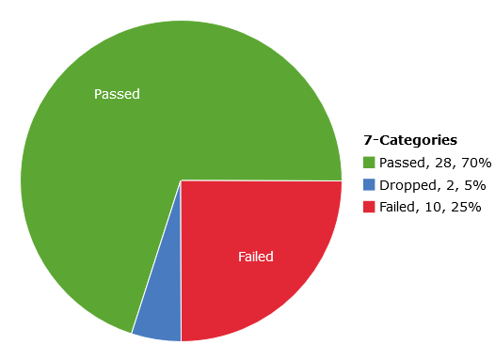
7) The last time Mr. Woodbury taught Math 21 in the summer, 28 students passed, 2 dropped, and 10 failed.
Create a pie chart to represent these data.

Slide 9
8) Here is a frequency distribution showing the ages of 66 people at a baseball game.
Ages | Frequency
25 to 35 | 25
35 to 45 | 14
45 to 55 | 11
55 to 65 | 10
65 to 75 | 4
75 to 85 | 2

Slide 10
a) Construct a histogram to represent this data.

Slide 11
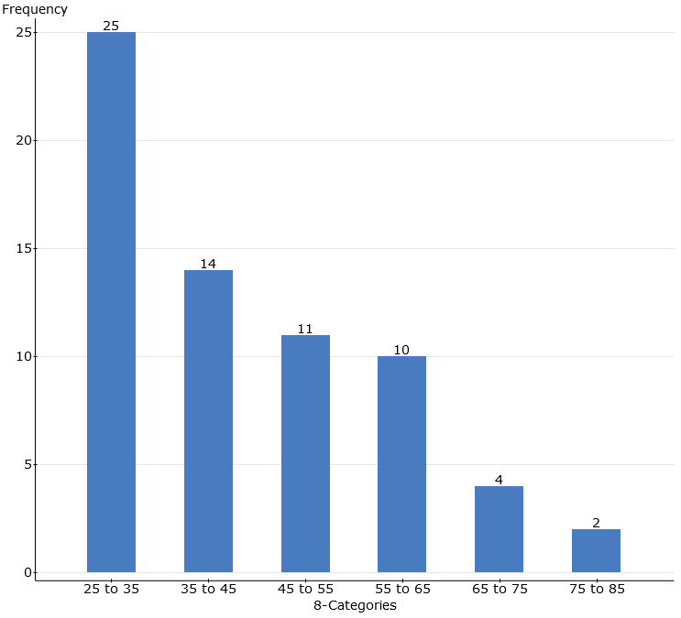

Slide 12
b) Create a relative frequency distribution.
Ages | Frequency
25 to 35 | 25
35 to 45 | 14
45 to 55 | 11
55 to 65 | 10
65 to 75 | 4
75 to 85 | 2

Slide 13


Slide 14
c) Describe the shape of the distribution.

Slide 15
9) Ten men who were at least 60 years old were selected at random and their serum cholesterol level was measured.
Here are their levels, in mg/dL.
177 197 190 185 231 160 181 285 222 197
Calculate the following:
Mean, Median, Mode, Q1, Q3
Range, Interquartile Range, Standard Deviation, Variance
Construct a boxplot. Identify any outliers.

Slide 16
Mean | Median | Mode | Q1 | Q3
202.5 | 193.5 | 197 | 181 | 222
Range | IQR | Std. dev. | Variance
125 | 41 | 35.653424 | 1271.1667

Slide 17
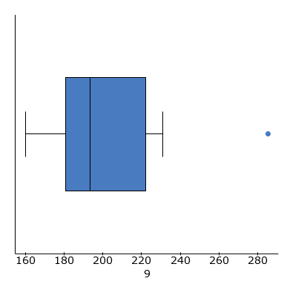

Slide 18
10) Use the stem-and-leaf display to find the 5-number summary (Min, Q1, Median, Q3, Max) for this data, and draw a boxplot. Be sure to denote outliers on your graph.
(There are 55 values.)

Slide 19
Stem | Leaf
3 | 2 3 4 5 5 5 6 7 8 8 8 9
4 | 0 0 0 1 1 1 2 3 3 4 4 5 5 5 6 8 9
5 | 0 0 1 1 1 1 4 5 6 6 7 8 9
6 | 0 1 1 3 4 5 6
7 | 1 4 5 7
8 | 1
9 | 6

Slide 20
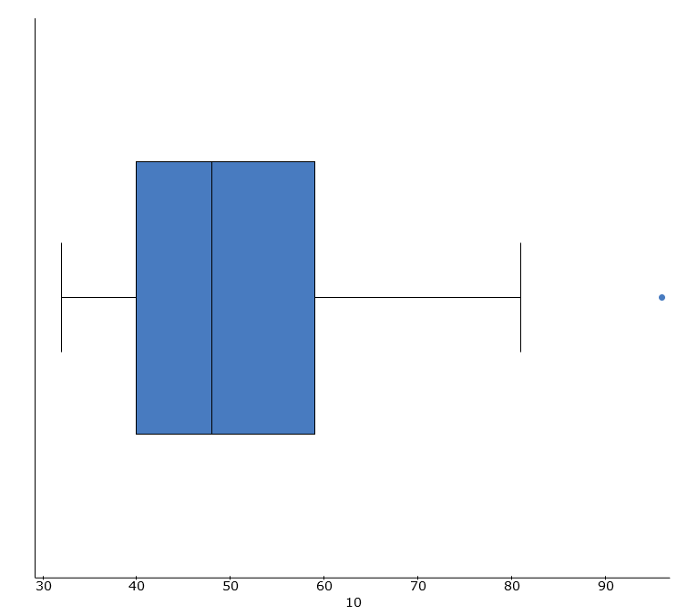

Slide 21
11) Here are the number of hours that ten students spent studying for a final exam, and their score on that exam.
Hours | Score |  | Hours | Score
7 | 70 |  | 5 | 66
8 | 76 |  | 9 | 82
4 | 57 |  | 6 | 64
9 | 77 |  | 16 | 96
13 | 91 |  | 3 | 50

Slide 22
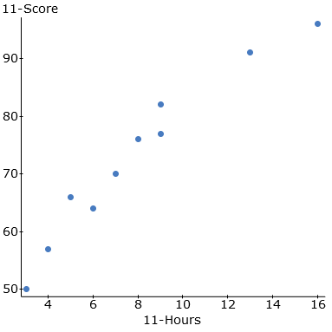
a) Create a scatterplot for these data.

Slide 23
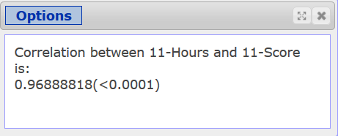
b) Compute the correlation coefficient r.

Slide 24
c) Determine whether there is a linear association between hours studied and exam score. If so, is it positive or negative?

Slide 25
12) Here are the scores of five randomly selected students on Test 1 and Test 2 in a math class.
Test 1 | Test 2
83 | 82
86 | 84
76 | 63
92 | 83
71 | 55

Slide 26
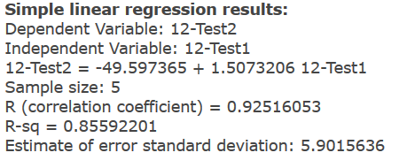
a) Find the equation of the regression line, treating the score on Test 1 as x and the score on Test 2 as y.

Slide 27
b) What is the slope of the line? What does the slope tell you?

Slide 28
c) Predict the Test 2 score for a student who had a score of 80 on Test 1.

Slide 29
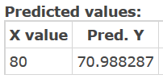
c) Predict the Test 2 score for a student who had a score of 80 on Test 1.

